Slide 1
Software Design & Architecture Lecture 1
SESD-2222
Fall 2024
M Khizar Hayat
Khizer.hayat@ucp.edu.pk
Office: Building D, 2nd floor
OFFICE HOURS: Tuesday : 02:00 PM- 04:00 PM
Friday: 11:00 AM- 01:00 PM

Slide 2
Today’s Agenda
Course Introduction
Course Guidelines
Grading Policy
A Quick Revision of Software Process
SDLC Phases
Example of SDLC Phases
Software Process Models

Slide 3
Guidelines
The course outline is tentative.
Evaluation will be based on all class discussions, handouts, recommended readings, slides etc.
Active participation is required.
Announcements etc. will be made via Portal

Slide 4
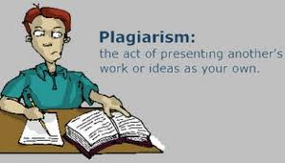
Plagiarism
All the parties involved will be awarded Zero in first instance. Repeat of the same offense will result in (F) grade.
USE PROPER REFERENCING IF ANY MATERIAL TAKEN FROM SOME WEB SOURCE/Book.

Slide 5
Tentative Grading Criteria
Class Participation/Activities | 5%
Quizzes (Announced +Unannounced) (5-6) | 20%
Assignments (4) | 15%
Midterm Exam | 20%
Final Exam | 40%

Slide 6
Class Rules
Attendance will be taken within first 10 minutes of the start of class. All students coming after 10 minutes will be marked as late. A student being absent from class for whatsoever reason will be marked as absent. For medical leaves you can contact Dean/HOD office.
No retakes of quizzes in any case.
Assignments should be submitted on time. Late Submission Policy:
24 hours late with 25% deduction in marks
48 hours late with 50% deduction in marks
More than 48 hours, 100% deduction
Assignments must be submitted via portal only. Emailed submissions will not be accepted in any case.

Slide 7
Text Book
Some textbooks may be helpful :
Recommended Text Book:
Software Engineering, A Practitioner’s Approach, Pressman R. S.& Maxim B. R., 8th Edition (2015), McGraw-Hill.
Reference Book:
Software Architecture and Design Illuminated, Kai Qian, Xiang Fu, Lixin Tao, Chong-Wei Xu, Jorge L. Diaz-Herrera, Jones and Bartlett Publishers
SAMS Teach Yourself UML in 24 Hours, 3rd Edition by Joseph Schmuller

Slide 8

Let’s have a quick revision

Slide 9
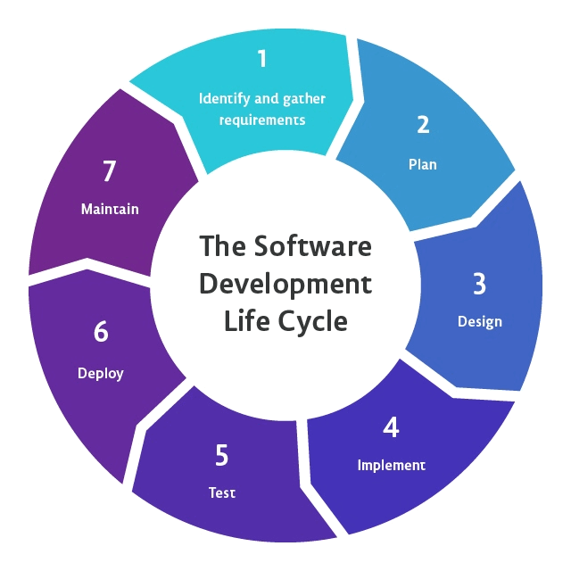
Software Process
Review Software Process
SDLC Phases

Slide 10
Main Phases of Software Process
Requirements Analysis (answers “WHAT?”)
Specifying what the application must do
Design (answers “HOW?”)
Specifying what the parts will be, and how they will fit together
Implementation (A.K.A. “CODING”)
Writing the code
Testing (type of VERIFICATION)
Executing the application with test data for input
Maintenance (REPAIR or ENHANCEMENT)
Repairing defects and adding capability

Slide 11

SDLC Phase 1: Requirement Analysis
The process of understanding what’s needed or wanted, and expressing the results in writing
Key Challenges of Requirement analysis ???

Slide 12
Key Challenges: Requirement Analysis
Stakeholder issues
Engineer/developer issues
The management issues
The expert issues
The budget issues
The planning issues
The novelty issues

Slide 13
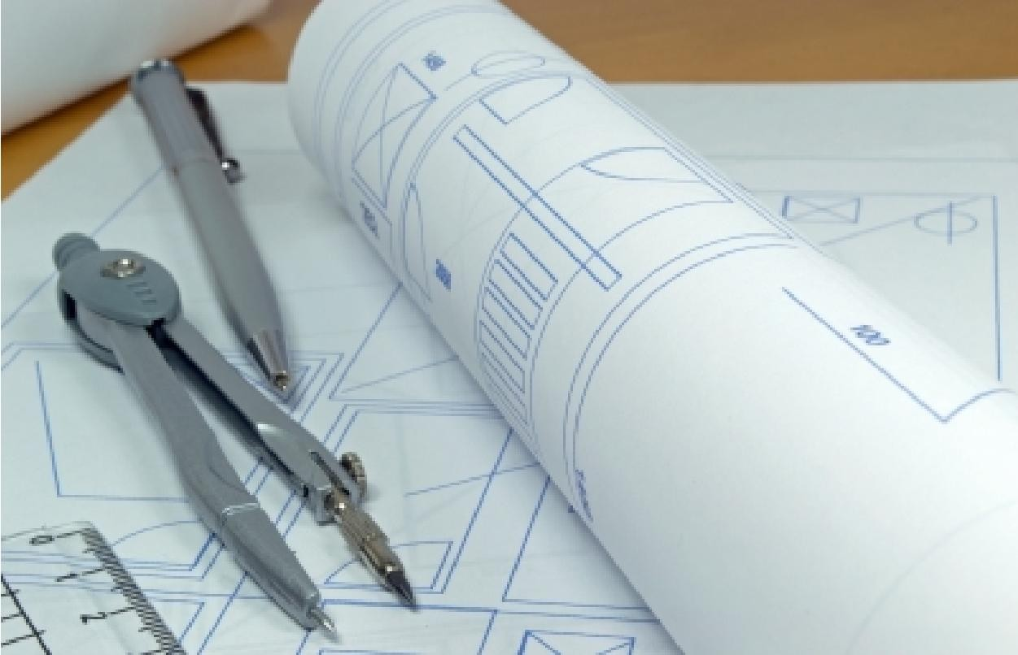
SDLC Phase 2: Design
The design of an application expresses how the application is to be constructed.
It describes the parts involved and how they are to assembled.
It consists of a set of documents (diagrams and text)

Slide 14
SDLC Phase 3: Implementation
In the form of coding
Code only against a design
Before compiling, satisfy yourself that the code you have typed is correct. Read it thoroughly.
‘correct’ means that is satisfies what’s required of it
This is “author-inspection” (What is it???)
Author Inspection:
Inspect and edit the block of code you have just written until you are convinced it does exactly what it is meant to do. Only then compile it.

Slide 15
SDLC Phase 3: Implementation (Cont...)
Build-a-little-Test-a-little (Rule)
Add a relatively small amount of code (“build-a-little”)
(Again): Read what you have typed and correct it if necessary until you are totally satisfied it’s correct
Compile
Test the new functionality (“test-a-little”)

Slide 16
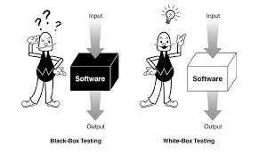
SDLC Phase 4: Testing
The testing phase consists of supplying input to the application and comparing the output with that mandated by the software requirements specification.
Helps to uncover defects
Proves the presence of defects, but never their absence
Types of Testing: Black-Box Testing, White-Box Testing

Slide 17


SDLC Phase 4: Testing (Cont...)
Tips on Testing
Test early and often
Test with extreme values
Very small, very big, etc.
Borderline
“Illegal” values
Vary test cases
Don’t repeat tests with same test data except when specifically intended

Slide 18
SDLC Phase 5: Maintenance
Maintenance refers to the work performed on the application that occurs after it has been delivered.
Types of maintenance
Corrective (Defect Removal)
Finding and fixing all inconsistencies with the requirements document
Perfective (Enhancement)
Introducing new or improved capability
Adaptive
Adapts software to new environment
Preventive
Changing some aspect of the system to prevent failures

Slide 19
Software Process Phases Example
Personal Finance Example:
Requirements Analysis: Diagrams and text
The application shall display the balance in the user’s bank account.
Design: Diagrams and text
The design will consist of the classes CheckingAccount, Savings Account etc.
Implementation: Source code
class Checking Account{ double balance; … }
Testing: Test cases and test results
With test case: the balance was $2938.22, which is correct.
Maintenance: Modified design, code, and text
e.g., Defect repair: “Application crashes when balance is $0 and attempt is made to withdraw funds. …”
e.g., Enhancement: “Allow operation with £.”

Slide 20
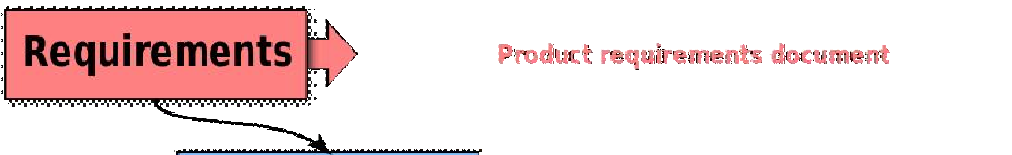
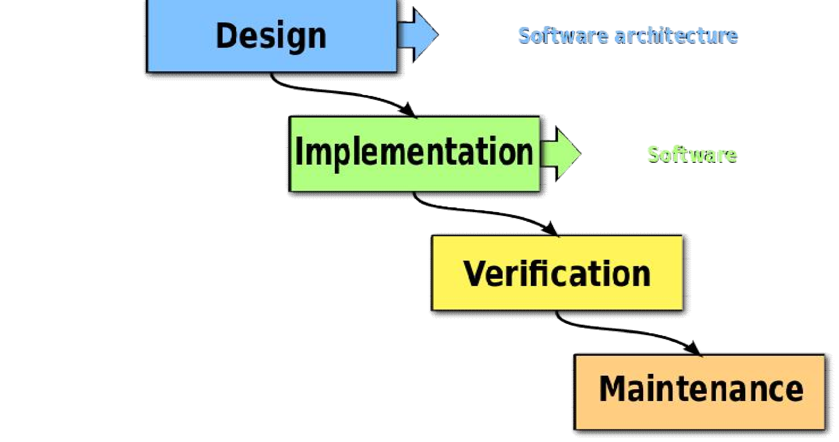
The Waterfall Software Process

